Slide 1
AUTOMATIC ATTENDANCE SYSTEM
Presented By :
Koduru Pooja - 18011A0420
Saka Srinivasulu - 19015A0422
Reshma - 18011A0437
Sharafuddin - 18011A0459
UNDER THE GUIDANCE OF
Dr. Makkena Madhavi Latha
Professor Of ECE & Director,
Academic and Planning JNTUH

Slide 2
CONTENTS
Introduction
Goal and Methodology
Need for Face Recognition system
Flowchart
Face Detection
Feature Extraction
Face Recognition
Updating Attendance
Results
Advantages and Disadvantages
Future Scope
Conclusion

Slide 3
INTRODUCTION
Face recognition systems have upgraded appreciably in their management over the recent years and this technology is now vastly used for various objectives like security and in commercial operations.
Face recognition is a powerful field of research which is a computer based digital technology.
It is widely used in security systems and it can be compared with other biometrics such as fingerprint or eye iris recognition systems.
Face recognition being a biometric technique implies determination if the image of the face of any particular person matches any of the face images that are stored in a database

Slide 4
GOAL
The main objective of this work is to make the attendance marking and management system efficient, time saving, simple and easy.
METHODOLOGY
This proposed system aims to develop an automated system that records the student’s attendance by using facial recognition technology. Here faces will be recognized using face recognition algorithms. The processed image will then be compared against the existing stored record and then attendance is marked in the database accordingly.

Slide 5
Need for Face Recognition system
Old paper or file-based attendance systems have the following drawbacks -
Data manipulation
Possible human errors
Speed
Ineffective and outdated
Biometric attendance systems have following drawbacks -
Traits Non changeable Physical
Rate of Error
Delay
Difficulty in Scanning
Physical Challenges
Environmental Challenges

Slide 6
So we shift to an automatic attendance system. A facial recognition system is a computerized biometric software which is suited for determining or validating a person by performing comparison on patterns based on their facial appearances. The following are the reasons why face recognition system is more advantageous-
Safety and Security
Convenience
Customer Service
Healthcare Advances

Slide 7
FLOWCHART
Face Detection
Feature Extraction
Face Recognition
Updating Attendance

Slide 8
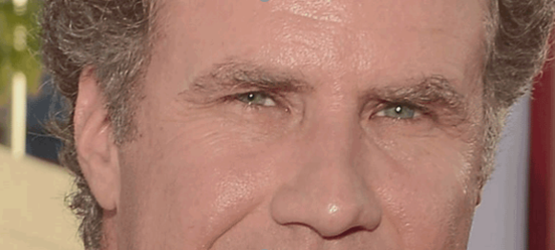

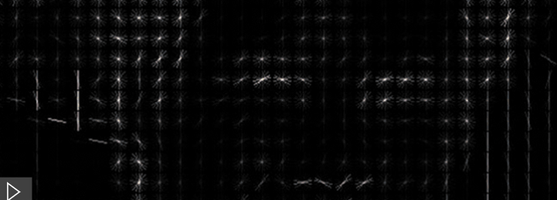
FACE DETECTION
Face Detection is done by using Histogram Of Gradients (HOG) method.
Every pixel is replaced by an arrow. These arrows are called gradients and they show the flow from light to dark across the entire image.
Fig : Gradient of a Pixel
Fig : HOG TRANSFORM

Slide 9
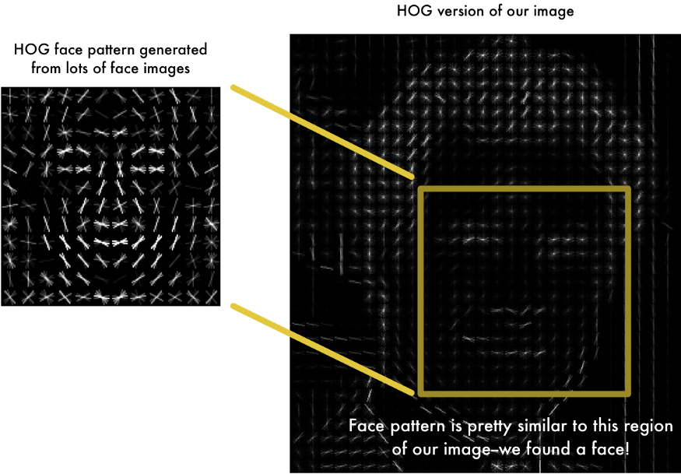
The original image is turned into a HOG representation that captures the major features of the image regardless of image brightness.
To find faces in this HOG image, all we have to do is find the part of our image that looks the most similar to a known HOG pattern.
Fig : FACE DETECTION

Slide 10
FEATURE EXTRACTION
The measurements that seem obvious to humans (like eye colour) don’t really make sense because a computer looks at individual pixels in an image.
The most accurate approach is to let the computer figure out the measurements to collect itself.
The algorithm looks at the 128 measurements of the image it is currently generating. It then tweaks the neural network slightly so that it makes sure the measurements it generates for two different images of the same person are quite closer while making sure the measurements for two different people are quite different.

Slide 11
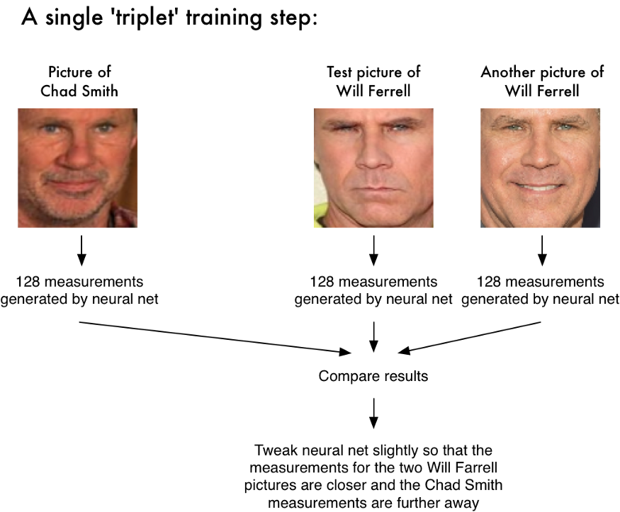
Fig : Tweaking a neural network
We need to run our face images through the pre-trained network to get the 128 measurements for each face. The network generates nearly the same numbers when looking at two different pictures of the same person

Slide 12
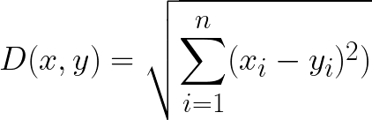
FACE RECOGNITION
Face Recognition is done by finding face distance between the images.
The Euclidean distance can be used to to measure the absolute distance between points in N-dimensional space
It is calculated as –
For face recognition, smaller values indicate more similar faces.
For a match the face distance value is closer to 0, whereas the value is close to 1 if the two images are dissimilar.

Slide 13
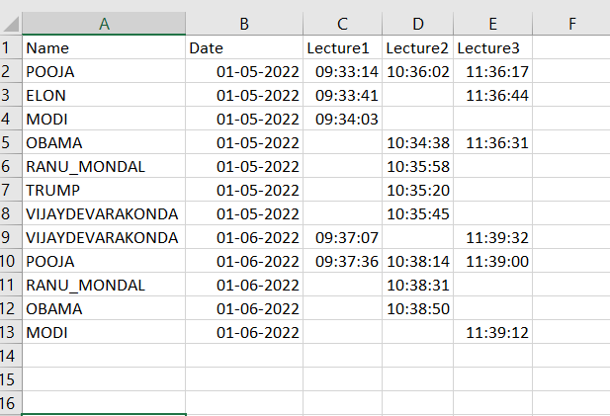
UPDATING ATTENDANCE
Once there is a match attendance is marked for a particular lecture only by comparing with the current time. If the time is out of the lecture time, then face is recognised but attendance is not marked.
The Attendance marked is stored in a CSV file. It is even displayed in the output. For readability, we can open in excel sheet and view the results.
If a person doesn’t attend previous lectures on the same day, the cell is left blank, indicating absent
These are the fields in the attendance sheet-

Slide 14
NEW REGISTRATION
If an unknown face is detected, then the user is prompted for registration.
The registration is password protected.
If the correct Password is entered , then we are prompted to enter the name, upon which the unknown user is registered with their name as the identity in our database
If the password is wrong, a warning for unauthorised registration is generated, and no further processing of the unknown user is done.

Slide 15
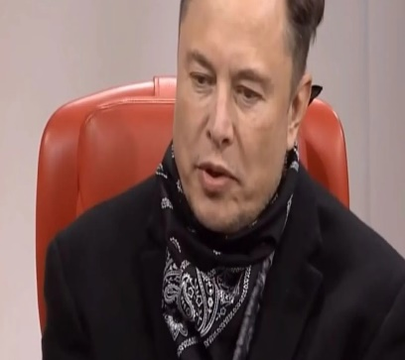
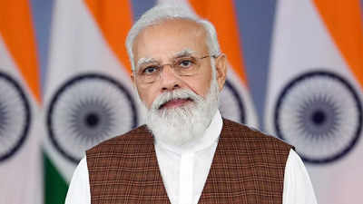
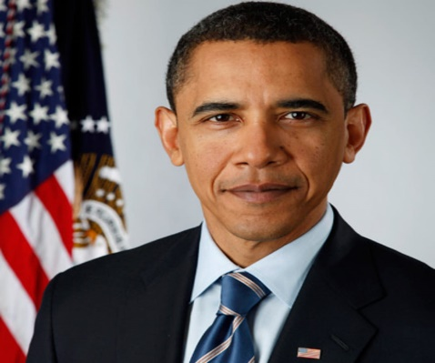

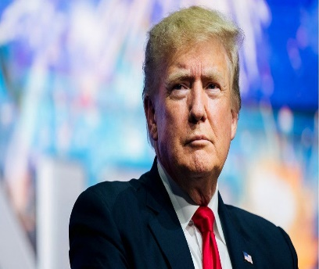

RESULTS
IMAGES IN DATABASE
ELON MUSK
MODI
OBAMA
RANU MONDAL
TRUMP
VIJAY

Slide 16
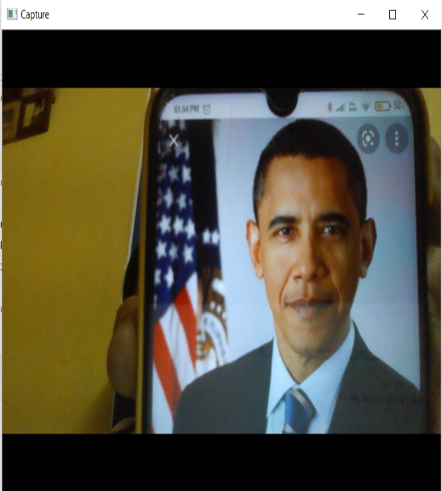
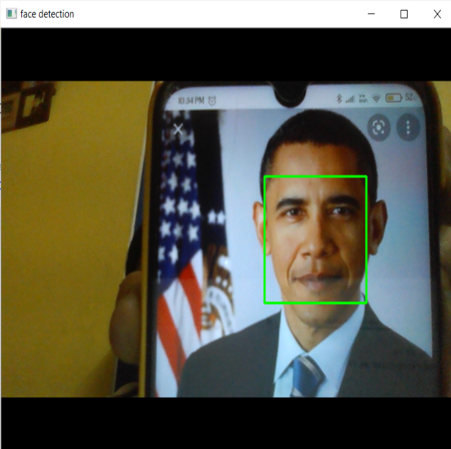
FACE DETECTION
Capturing an image
Face Detection

Slide 17
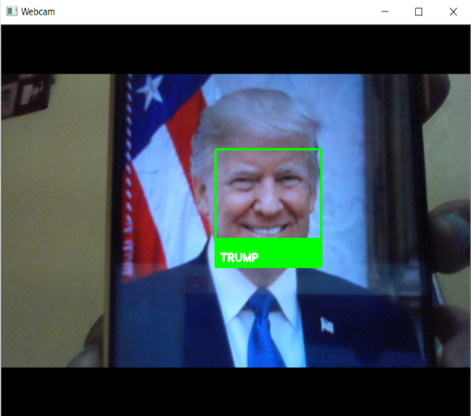
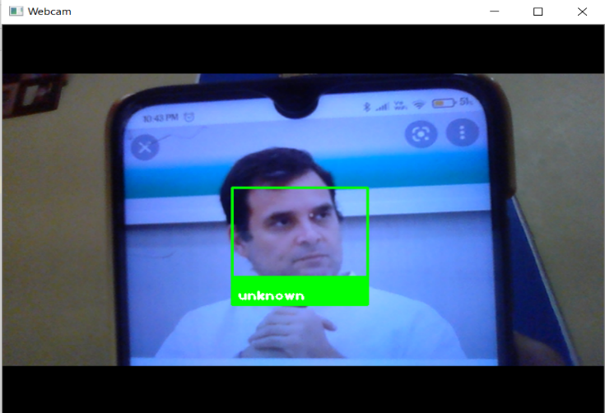
FACE RECOGNITION
Face Recognition
Unknown Face Recognition

Slide 18
UPDATING THE ATTENDANCE

Slide 19
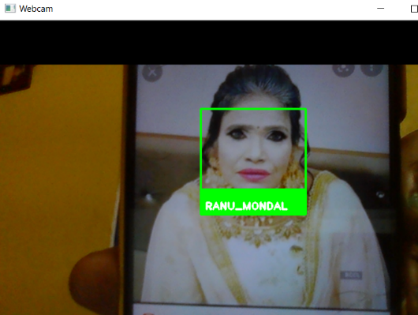
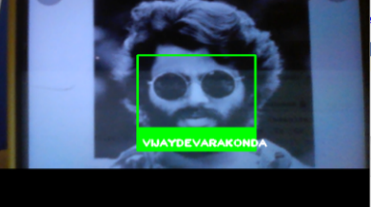
FACE RECOGNITION IN DIFFERENT SCENARIOS
MAKEOVER
BEARD

Slide 20
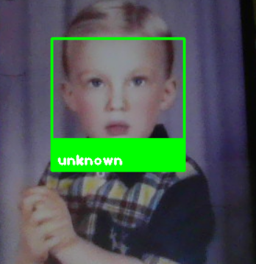
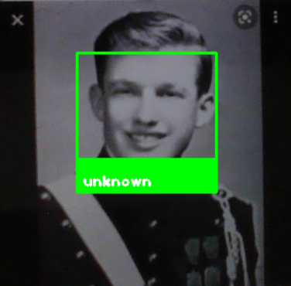

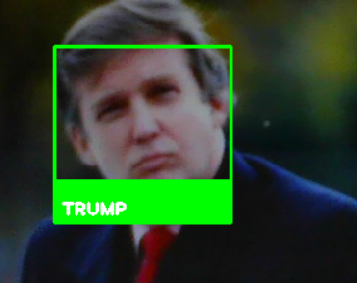
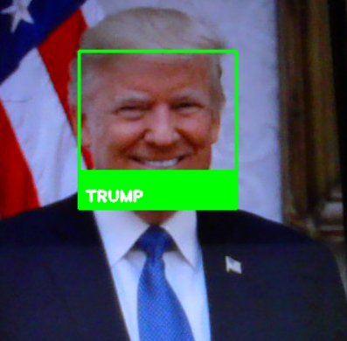
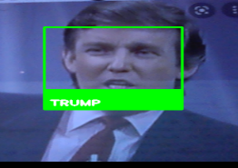
AGE
Original Image
Childhood Image
Teenage Image
Early 20’s Image
Late 30’s Image
At age of 50

Slide 21

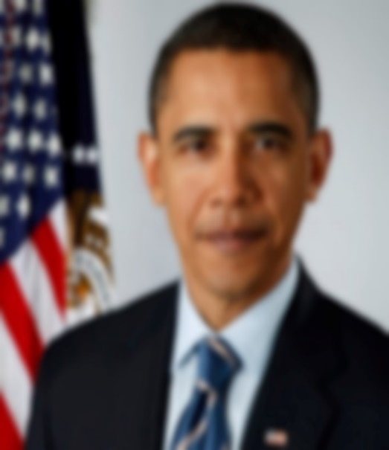
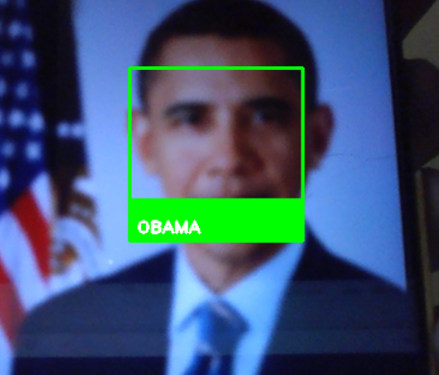
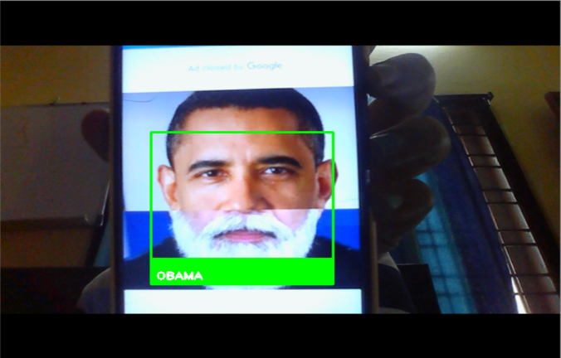
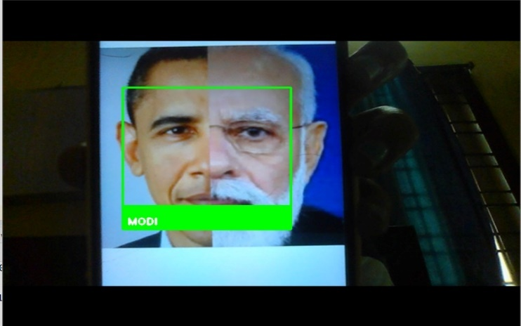
BLUR
Original Image
Blurred image
Face Recognition
COMBINING FACES
Combination of 40% and 60% faces
Combination of 65% and 35% faces

Slide 22
ADVANTAGES
Better security
Easy to integrate
Automated identification
Entry and Exit time automated record.
Cost-effective

Slide 23
DISADVANTAGES
Huge storage requirements
Machine learning technology requires powerful data storage
Detection can be vulnerable.
We’ve outlined the way in which facial detection can be thrown off
Potential privacy issues
There is disagreement on whether face detection is compatible with
human privacy rights.

Slide 24
FUTURE SCOPE
Almost all academic institutions require attendance record of students and maintaining attendance manually can be hectic as well as time consuming task.
The future scope of the proposed work can be, capturing multiple detailed images of the students and using any cloud technology to store these images.
The system can be configured and used in ATM machines to detect frauds.
Also, the system can be used at the time of elections where the voter can be identified by recognizing the face.

Slide 25
CONCLUSION
As a conclusion, this proposal successfully uses various image processing techniques for face recognition and updating attendance.
It uses the Hog representation of images to detect faces in an image.
It utilizes face encoding approaches for feature extraction.
The results of Feature extraction act as an accurate method of face recognition using Euclidean face distance.
It proposes an image processing system that uses Python software for Automatic attendance update system.
This proposed system solves the potential problems of the classic attendance marking systems, which are inefficient and time consuming and pose a risk of proxies.

Slide 26
THANK YOU

